Slide 1

Indian Crime Incidents
2019 -2024

Slide 2
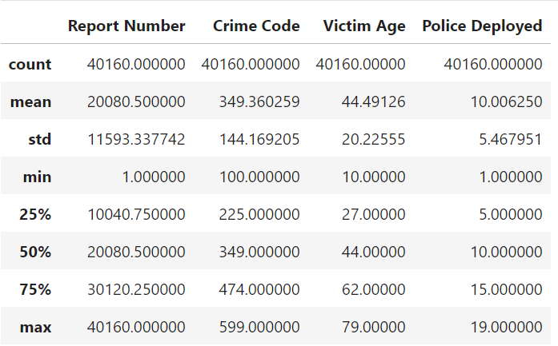
Numerical Analysis
Total Case Reports – 40160
Average Victim’s age is around 44-45.
25% of Crimes were registered with Senior Citizens
25% of Cases required a large number of Police Forces.
And the Average of 10 Police Deployed in each case.

Slide 3
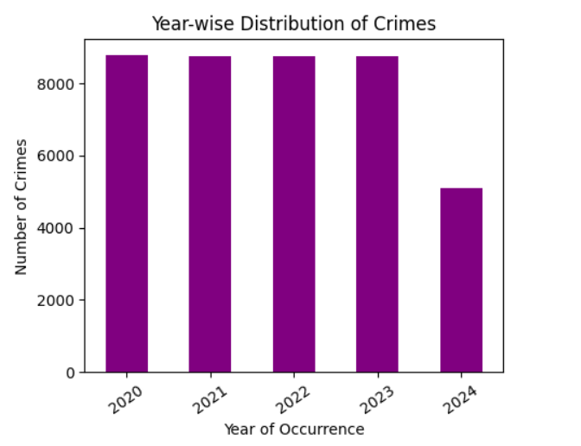
Univariate Analysis
Number of Crimes Reports Remained the same throughout the years.
Since 2024 is an ongoing year, the lower crime count 2024 might be due to incomplete data, as the year is still in progress.

Slide 4
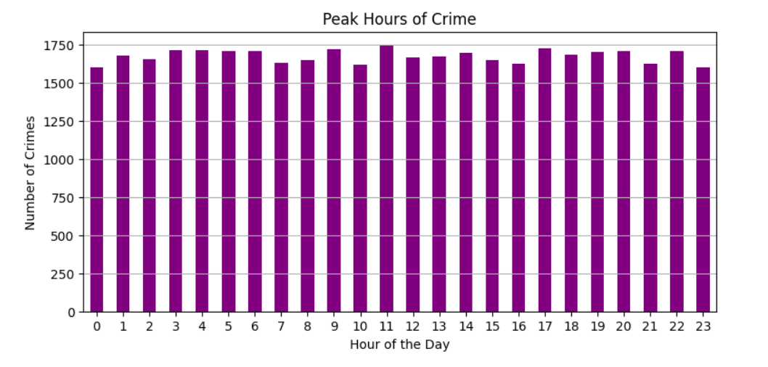
Univariate Analysis
The number of crimes seems fairly consistent across all hours, with no single hour showing an extreme peak or dip.
There is no clear spike in crime rates during particular hours, meaning there are no specific "peak hours" where crime is drastically higher than at other times.

Slide 5
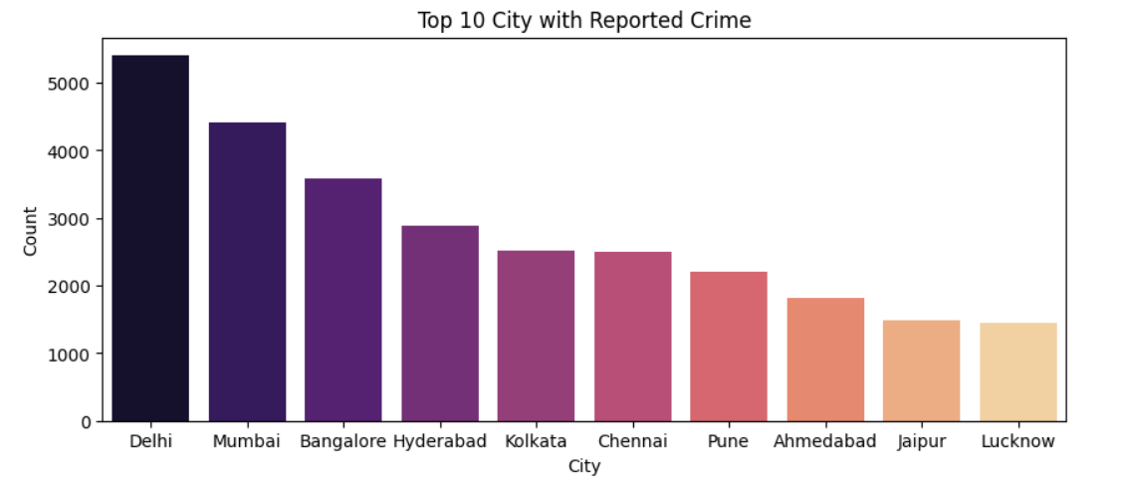
Univariate Analysis
Delhi has the highest crime rate, while Lucknow reports the least.
There is a gradual decline in crime counts from Delhi to Lucknow.
Major metropolitan cities like Mumbai, Bangalore, and Hyderabad also experience high crime counts, though much less than Delhi.

Slide 6
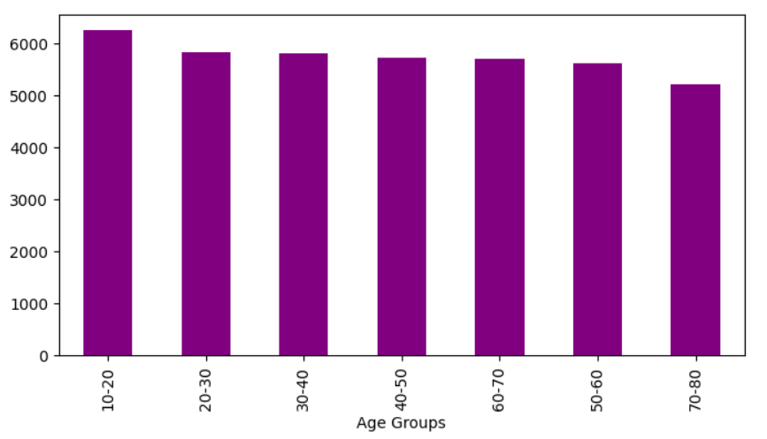
Univariate Analysis
The youngest age group (10-20) is the most involved in or affected by crimes, possibly due to higher risk factors or vulnerability.
All other age groups (except 70-80) show almost uniform crime distribution, indicating that crime impacts a wide range of age groups consistently.

Slide 7
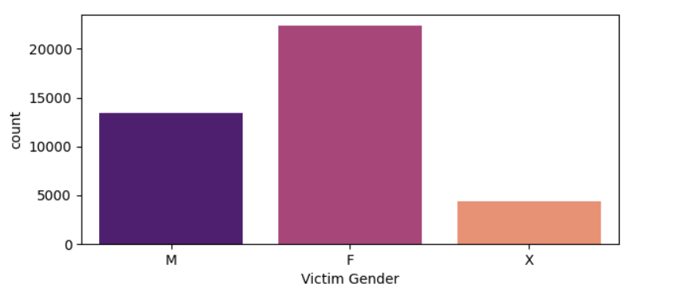
Univariate Analysis
Females being more affected by crime suggests underlying social and systemic factors that expose women to higher risks.
Significant numbers of X Genders have also been found affected.

Slide 8
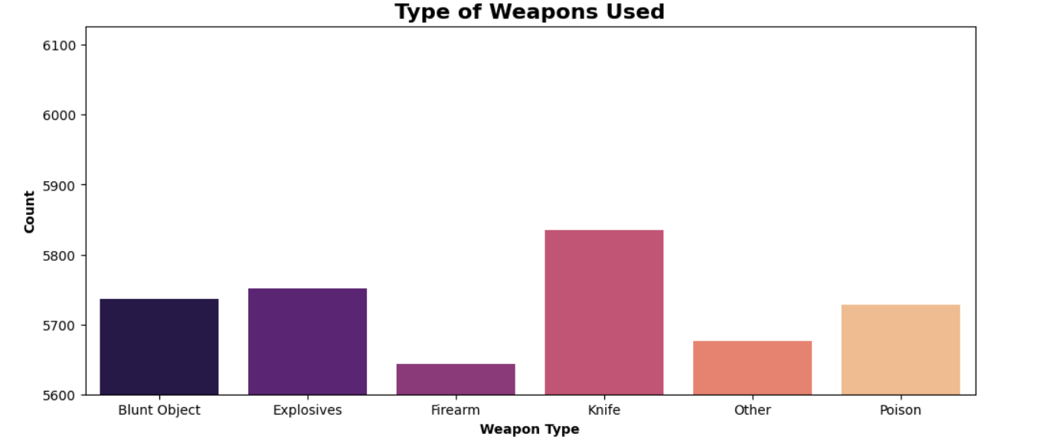
Univariate Analysis
1. The knife has been found the most used weapon in crime incidents.
Indicating the easy availability.

Slide 9
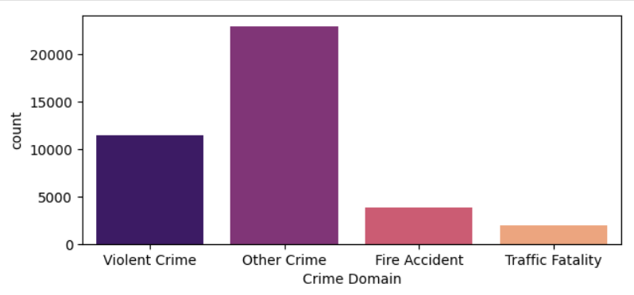
Univariate Analysis
Other Crimes have been reported in large numbers such as burglary, theft, Impersonification, Kidnapping, Cyber Crime, etc.
Whereas Violent Crimes have been the Second Highest.

Slide 10
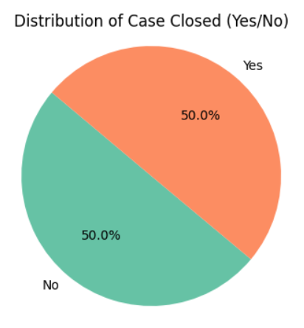
Univariate Analysis
50% of the Reported Cases have been close i.e. the judgment has been made or the procedure of law and order has been completed.
Whereas 50% of the cases have still been pending.

Slide 11
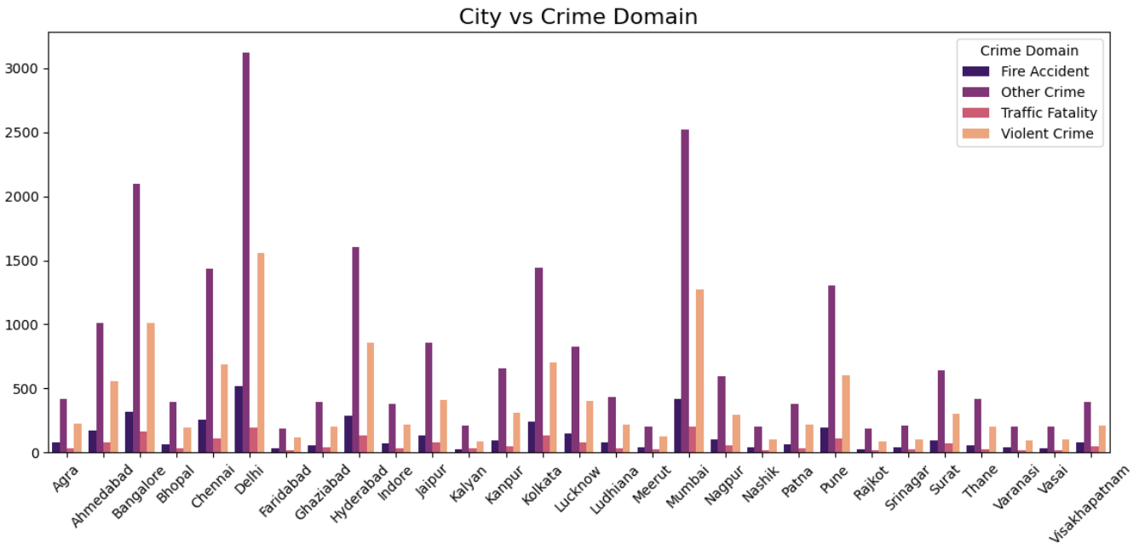
Bivariate Analysis
Other Crimes including Homicide, Burglary, Vandalism, Kidnapping, Public intoxication, Cyber Crime, Illegal possession, etc are most common and also found to be reported most in metro cities like Delhi, Bangalore, Mumbai, Pune, etc.

Slide 12
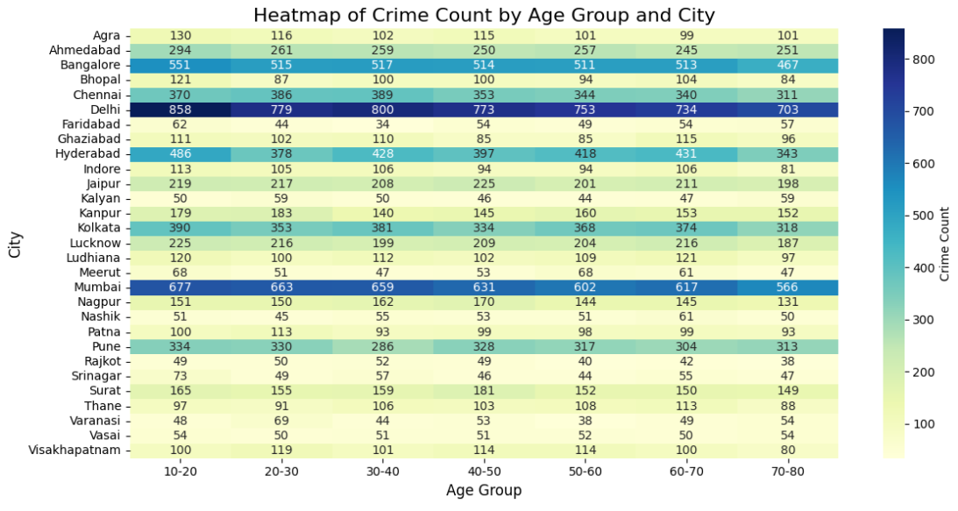
Bivariate Analysis
Age Group 10 – 20 is significantly more affected, especially in metro cities like Delhi, Mumbai & Hyderabad.

Slide 13
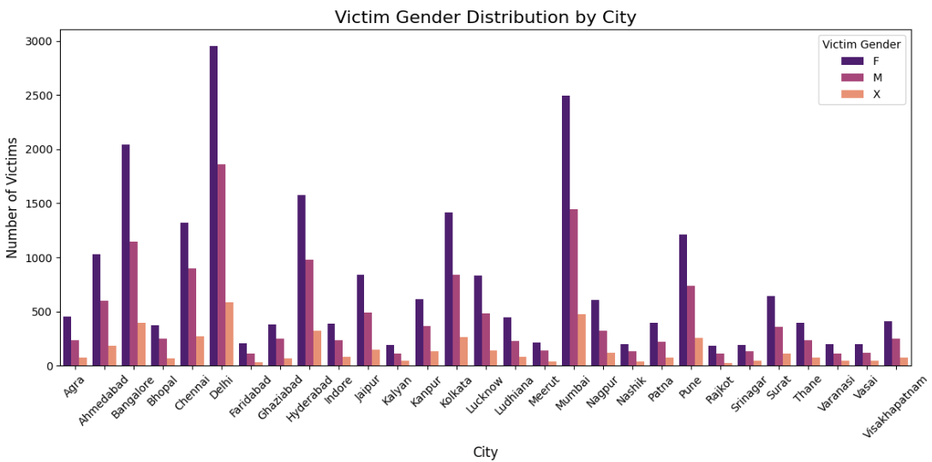
Bivariate Analysis
Females are found to be more affected in every city.

Slide 14
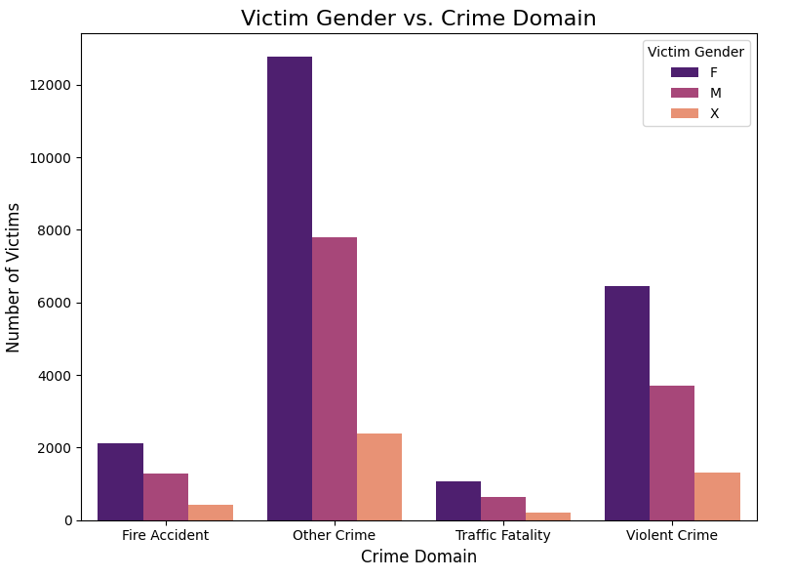
Bivariate Analysis
In Every Crime Domain Females are Found to be Mostly Affected.

Slide 15
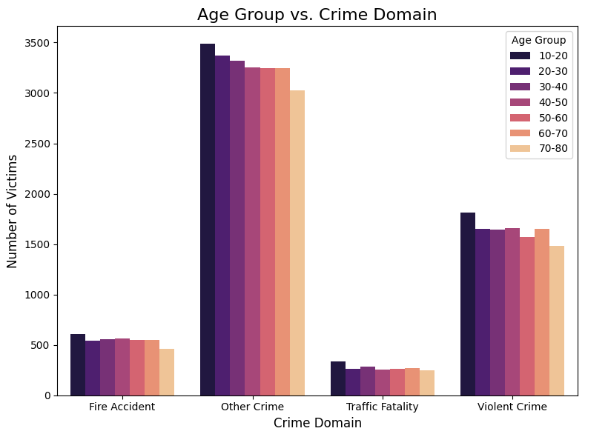
Bivariate Analysis
Younger age groups (10-40 years) are more affected across most crime domains, especially in Other Crime and Violent Crime.
Elderly people (60-80 years) are less frequently victims in all crime domains, especially in Other Crime.
There is a consistent pattern of lower victim counts in Traffic Fatality and Fire accidents across all age groups.

Slide 16
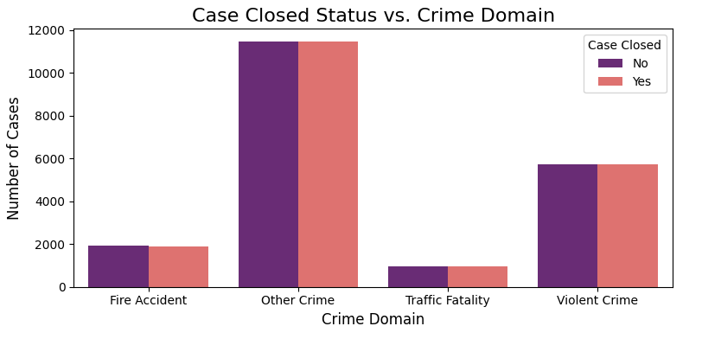
Bivariate Analysis
Other Crime dominates the dataset regarding total case count, suggesting this category has the most incidents, but closure rates are also high.
Violent Crime and Fire Accidents have similar trends in terms of case closure, with a balance between closed and open cases.
Traffic Fatalities represent a smaller proportion of overall cases, with a slight gap between open and closed cases.

